Slide 1
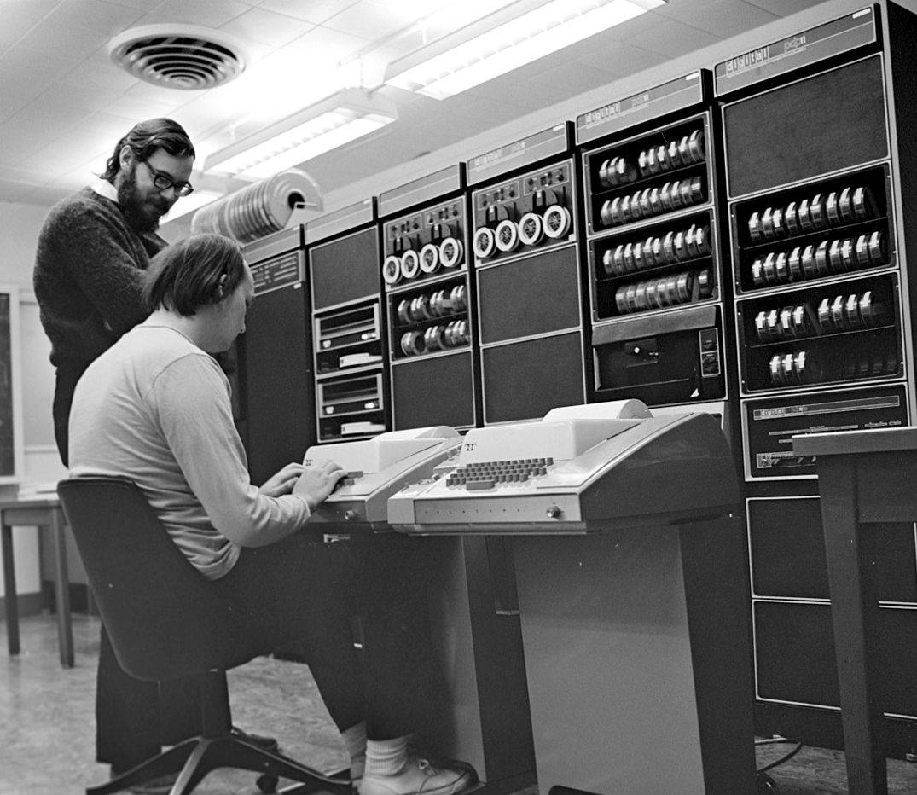
The UNIX Philosophy
What it is and why it still matters for solid system, software and solution design
Scott McCrory – 1/13/2021
The Huntington National Bank is Member FDIC. ®, Huntington® and Huntington. Welcome.® are federally registered service marks of Huntington Bancshares Incorporated. © 2019 Huntington Bancshares Incorporated.
Image by Peter Hamer - Ken Thompson (sitting) and Dennis Ritchie at PDP-11Uploaded by Magnus Manske, CC BY-SA 2.0, https://commons.wikimedia.org/w/index.php?curid=24512134
Notes:
Presentation style used from stock MS PowerPoint installation. Photo of Kerningham and Richie licensed under Creative Commons from Wikipedia at https://en.wikipedia.org/wiki/Unix#/media/File:Ken_Thompson_(sitting)_and_Dennis_Ritchie_at_PDP-11_(2876612463).jpg

Slide 2
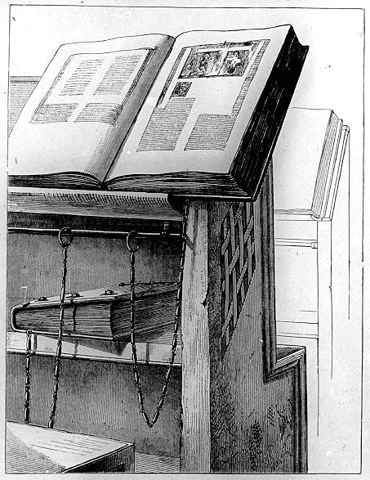
Agenda
Who am I and What is This About?
The Book and Approach
First, a Few Credits
The Unix Philosophy in a Nutshell
The Tenants, One by One
Wrap-Up and Q&A
Image by John Willis Clark - http://www.ib.hu-berlin.de/~wumsta/Milkau/109-2.jpg: Fritz-Milkau-Dia-Sammlung, erstellt in der Photographischen Werkstatt der Preußischen Staatsbibliothek von 1926-1933originally from The Care of Books by John Willis Clark (Fig 94, p132), Public Domain, https://commons.wikimedia.org/w/index.php?curid=135286
Notes:
Book image licensed under Public Domain from WikiPedia: https://en.wikipedia.org/wiki/Book#/media/File:Milkau_B%C3%BCcherschrank_mit_angekettetem_Buch_aus_der_Bibliothek_von_Cesena_109-2.jpg

Slide 3
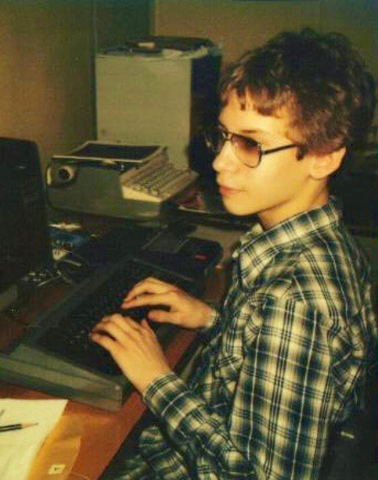
Who am I and what is this about?
I’m Scott McCrory, Sr. I.T. Enterprise Architect at Huntington National Bank
37 years in I.T. as a developer, system administrator, network engineer, solution delivery manager and architect
”A lot of today is just like yesterday”
Target Audience: Developers, and also system engineers, solution architects, enterprise architects and anyone else implementing I.T.
Notes:
Image licensed by Scott McCrory, employee of Huntington National Bank: scott.mccrory@huntington.com. Own work.

Slide 4

The Book and Approach
Early midrange engineers tackled the concepts of distributed development, modularity and reusability, spawning a huge "software tools" movement
In 1984, Rob Pike and Brian W. Kernighan published "Program Design in the Unix Environment" in AT&T Bell Laboratories’ Technical Journal, in which they argued for the Unix philosophy of building small, focused programs that do only one thing but do this thing well, communicate via stdin/stdout and connect through “pipes”
Mike Gancarz wrote “The UNIX Philosophy” in 1995, underscoring simple, short, clear, modular, and extensible code that’s easily maintained and repurposed by developers other than its creators
The main theme here: Cohesion and Decoupling - Composability as opposed to monolithic design
These concepts still apply today – let’s discuss…!
https://www.amazon.com/UNIX-Philosophy-Mike-Gancarz-ebook/dp/B002OL2G4Gv

Slide 5
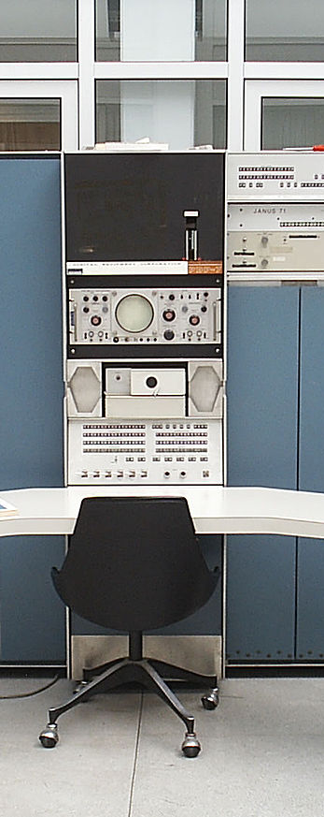
First, a Few Additional Credits
UNIX is one of the most successful I.T. inventions ever. As much as 70% of the Internet is composed of *nix
Most people credit Ken Thompson of AT&T with inventing the UNIX operating system, and in a sense they’re right – he wrote the first UNIX version in 1969 on a DEC PDP-7 minicomputer.
He then rewrote it in 1972 from assembly language into B and later into Dennis Richie and Brian Kerninghan’s C for portability
This set a precedent later extended by a cast of thousands including:
Doug McIllroy: Pipelines, spell, diff, sort, join, graph, tr
Joe Ossanna: Multics and troff
Lorinda Cherry: Interactive calculator, bc, dc, eqn, plotutils
Alfred Aho: Pattern scanning, parsing, sorting
Eric Allman: Electronic mail
Larry Wall: Patch utility, Perl command language, rn network news reader
And MANY, MANY more following a shared design philosophy…
Image by Toresbe - From english Wikipedia. Original description was: The Oslo PDP-7, before restoration started. I took the picture., CC SA 1.0, https://commons.wikimedia.org/w/index.php?curid=1963657
Notes:
Image licensed under Creative Commons: https://en.wikipedia.org/wiki/PDP-7#/media/File:Pdp7-oslo-2005.jpeg

Slide 6
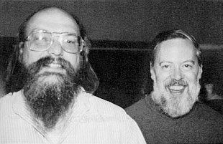
The UNIX Philosophy in a Nutshell (Gancarz)
Small is Beautiful
Make each program do one thing well
Build a prototype as soon as possible
Choose portability over efficiency
Store numerical data in flat ASCII files
Use software leverage to your advantage
Use shell scripts to increase leverage and portability
Avoid captive user interfaces
Make every program a filter
Image by Ben Lowe - https://www.flickr.com/photos/blowe/7984191331/, CC BY 2.0, https://commons.wikimedia.org/w/index.php?curid=31595770
Notes:
Richie and Kerningham’s photo licensed under Creative Commons at https://en.wikipedia.org/wiki/Brian_Kernighan#/media/File:Brian_Kernighan_in_2012_at_Bell_Labs_1.jpg

Slide 7
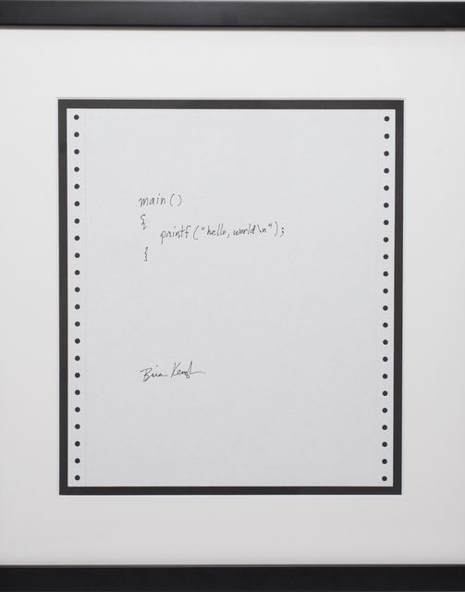
1. Small is Beautiful
Small programs are easy to understand
Small programs are easy to maintain
Small programs consume fewer system resources
Small programs are easier to combine with other tools
Examples: Libraries, microservices and containers
Also: Scoped datamarts, server tiers, purpose-built VLAN segments
Avoid giant monoliths: Modularity is your friend
Image by Brian Kernighan - https://learn.co/tracks/introduction-to-ruby/ruby-basics/introduction/hello-world, Public Domain, https://commons.wikimedia.org/w/index.php?curid=56193395
Notes:
1978 Brian Kerningham code image licensed under Public Domain from Wikipedia at https://en.wikipedia.org/wiki/The_C_Programming_Language#/media/File:Hello_World_Brian_Kernighan_1978.jpg

Slide 8
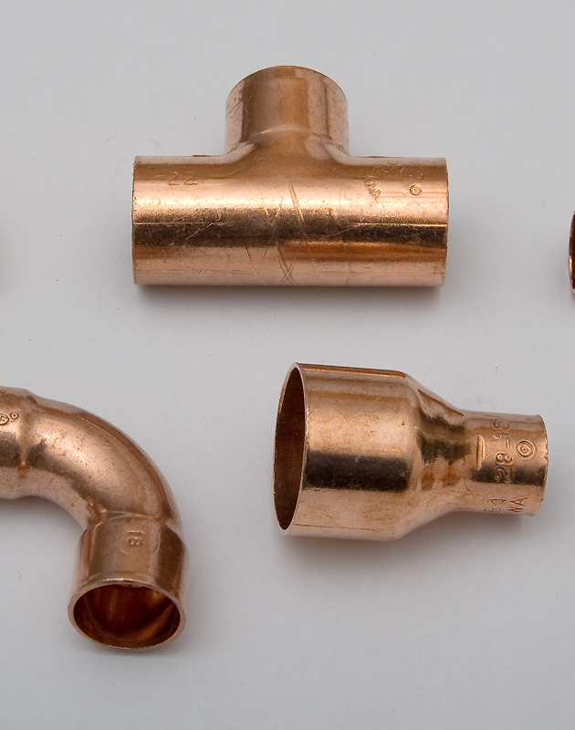
2. Make each program do one thing well
Like #1, the best program does one task in its life and does it well
This is again true of OOP’s libraries, packages, classes and methods, containers, ETL jobs, data schemas, deployment scripts and segmented infrastructure
Do avoid creeping featurism
Do aspire to High Cohesion and Loose Decoupling
Let’s talk for a moment about pipes…
Don’t be like “ls” and make assumptions about screen width and formatting (upward coupling)
Avoid giant monoliths (again!): Modularity is your friend
Image by Torsten Bätge - Own work, CC BY-SA 3.0, https://commons.wikimedia.org/w/index.php?curid=1929467
Notes:
Pipe fitting image licensed under Creative Commons from Wikipedia: https://en.wikipedia.org/wiki/Piping_and_plumbing_fitting#/media/File:Kupferfittings_4062.jpg

Slide 9
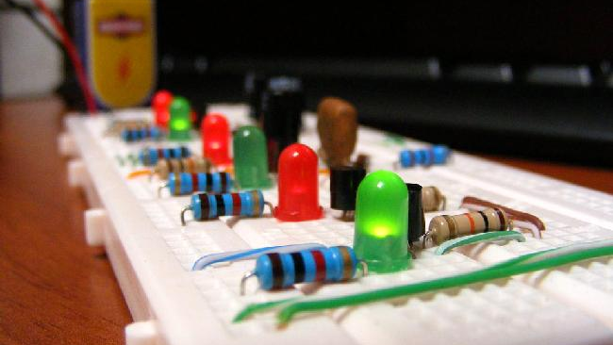
3. Build a prototype as soon as possible
Let’s admit it, we’re human
Everyone is on a learning curve
Even the masters know that change is inevitable
There’s a reason why it’s called “software”
So, think about prototyping as a learning process
Early prototyping reduces risk
It typically takes three iterations to get something right
Budget for refactoring, then let’s get the first two iterations out of the way early ☺
Sounds like Agile MVPs, doesn’t it?
Background image by By Josemontero9 - Juan José Montero Rodríguez - Own work, CC BY-SA 4.0, https://commons.wikimedia.org/w/index.php?curid=5630443
Notes:
Background image by By Josemontero9 - Juan José Montero Rodríguez - Own work, CC BY-SA 4.0, https://commons.wikimedia.org/w/index.php?curid=5630443

Slide 10

4. Choose portability over efficiency
Don’t over-optimize, just don’t. Next quarter’s hardware will run faster
The most efficient way is rarely portable; increased portability almost always overcomes the lack of speed
Portable software also reduces the need for user training
Good programs never die – they’re just ported to new hardware platforms
This is also true of competing IaaS, PaaS and SaaS offerings, so carefully rationalize couplings going in
Notes:
Image from stock clipart suggested by PowerPoint Design Ideas

Slide 11
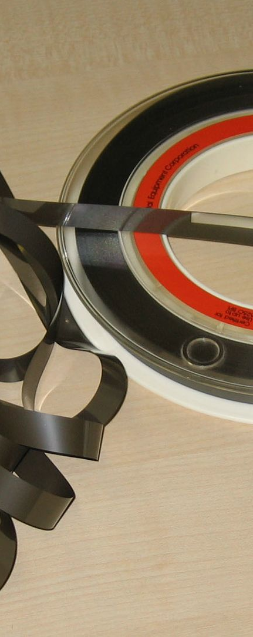
5. Store numerical data in flat ASCII files
Said more generically, “Store data in portable, easy-to-leverage forms”
Useful data must go somewhere – bits that sit on disks forever help nobody
Common interchange formats don’t require special conversions and are easily read and edited
Flat ASCII files are more reusable than proprietary binary formats
Can you think of other examples?
File operations
Databases with universal driver availability
RESTful web services
Identity and Access Management standards (e.g. SAML & OAuth)
Image CC BY-SA 3.0, https://commons.wikimedia.org/w/index.php?curid=121719
Notes:
Magnetic tape image licensed by Creative Commons from Wikipedia: https://en.wikipedia.org/wiki/Magnetic_tape#/media/File:Tapesticker.jpg

Slide 12

6. Use software leverage to your advantage
Good programmers write good code; great programmers “borrow” good code
Avoid the not-invented-here syndrome
Allow others to use your code to leverage their own work
Image by Krdan - Own work, Public Domain, https://commons.wikimedia.org/w/index.php?curid=1566238
Notes:
International recycling icon licensed under public domain from Wikipedia at https://en.wikipedia.org/wiki/Recycling#/media/File:Recycling_symbol.svg

Slide 13
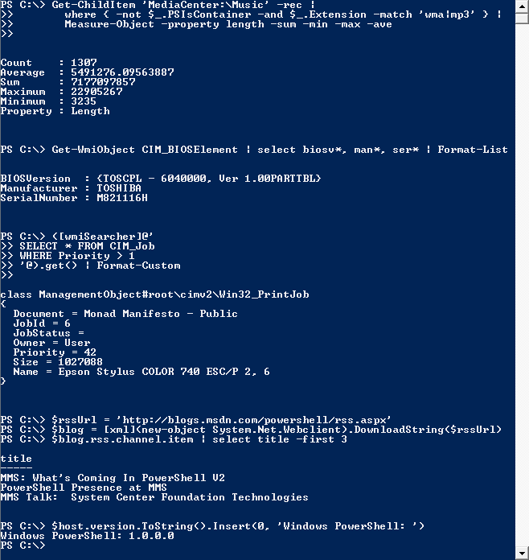
7. Use shell scripts to increase leverage and portability
“Shell scripts” provide awesome leverage and are more portable than compiled opcode
Resist the desire to rewrite shell scripts into compiled opcode
Perl’s and Python’s successes are in good part due to this principle. Puppet, Ansible, PowerShell and others are following a similar path
While we’re at it - Automate everything – DevOps, CI and CD, testing, API documentation…
Image by Microsoft Corporation - Screenshot taken by User:Ghettoblaster from en.wikipedia, Public Domain, https://commons.wikimedia.org/w/index.php?curid=11757570
Notes:
Powershell script image licensed under public domain from WikiPedia at https://en.wikipedia.org/wiki/PowerShell#/media/File:Windows_PowerShell_1.0_PD.png

Slide 14
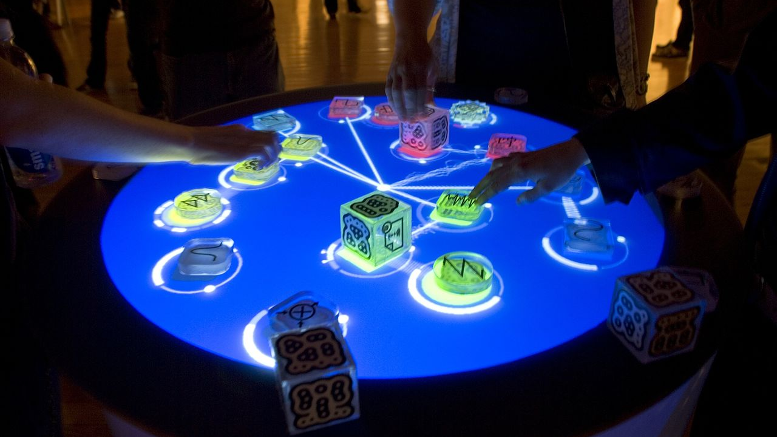
8. Avoid captive user interfaces
CUIs assume that the user is human
CUI command parsers are often big and ugly (especially if they’re HTML)
CUIs tend to adopt a “big is beautiful” approach (see small is beautiful)
Programs with CUIs are hard to combine with other programs without delicate Robotic Process Automation screen scraping
CUIs don’t scale well
CUIs don’t take advantage of software leverage
Lesson: Decouple your UIs and make integration easier
Background image by Daniel Williams from NYC, USA - The Reactable, CC BY-SA 2.0, https://commons.wikimedia.org/w/index.php?curid=2429598
Notes:
Background image licensed under Creative Commons from WikiPedia at https://en.wikipedia.org/wiki/User_interface#/media/File:Reactable_Multitouch.jpg

Slide 15
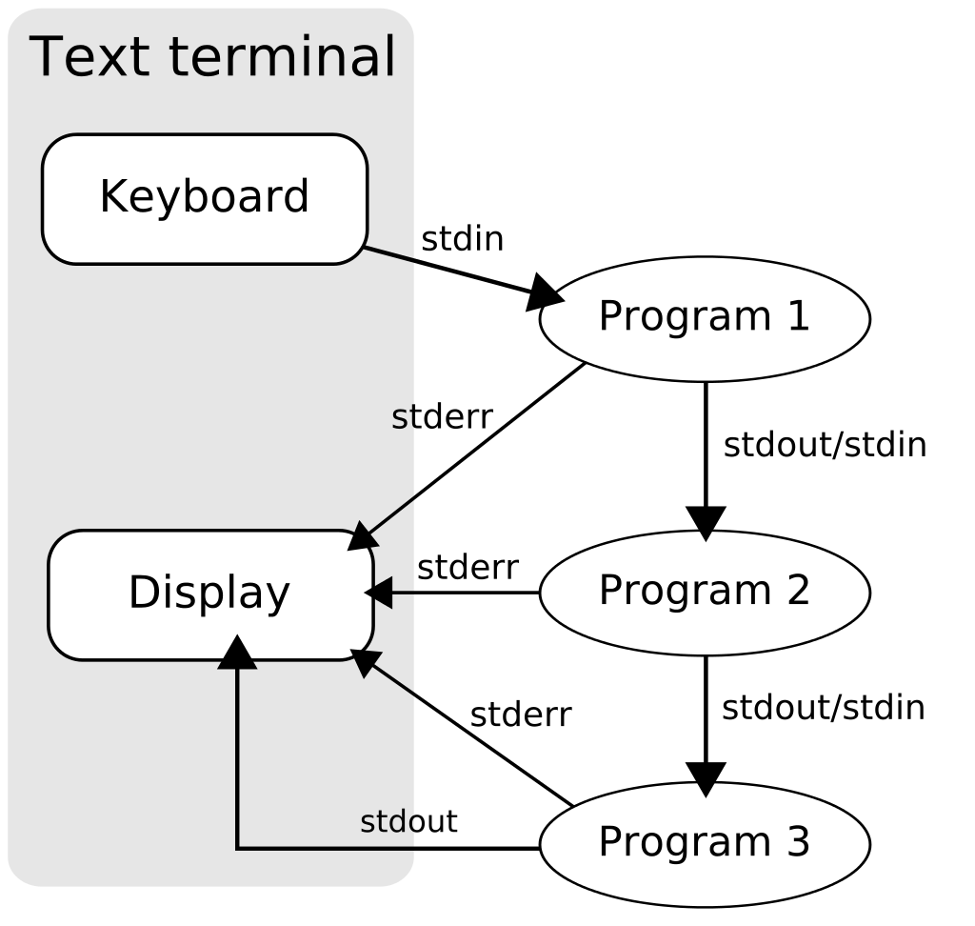
9. Make every program a filter
Every program since the dawn of computing is a filter
Say it again: Every program is a filter
Programs don’t create data, people do
Computers convert data from one form to another
In UNIX, streams and pipes are magic
Stdin for data input
Stdout for data output
Stderr for out-of-band output
Other examples: Separate data collection and reporting components using EDW and Analytics tiers, ETL, AOP, layered architectures, …?
Image by TyIzaeL - en:File:Pipeline.svg, Public Domain, https://commons.wikimedia.org/w/index.php?curid=11524651
Notes:
Image licensed under Public Domain from Wikipedia at https://en.wikipedia.org/wiki/Pipeline_(Unix)#/media/File:Pipeline.svg

Slide 16

Wrap-Up and Q&A
The Punchline
The UNIX Philosophy is just as relevant today as it was set forth in the 1970s and goes well-beyond OS design
Try to apply it to every part of I.T., not just software
The two concepts of Cohesion and Decoupling alone get you very far – embrace them relentlessly!
Open Discussion
Notes:
Image licensed under Pixabay License; Free for commercial use, No attribution required; from https://pixabay.com/illustrations/banner-header-question-mark-1090830/

